Slide 1
Computer Hardware Fundamentals

Slide 2

Welcome!
Notes:
ON SCREEN
Welcome! In this lecture, we will look into some computer hardware fundamentals.
You have probably seen most of these concepts before, such as in Computer Organization.
However, it is important to revisit some of them before we begin investigating Operating Systems.
Let’s get started!
[CLICK – Next Slide]

Slide 3
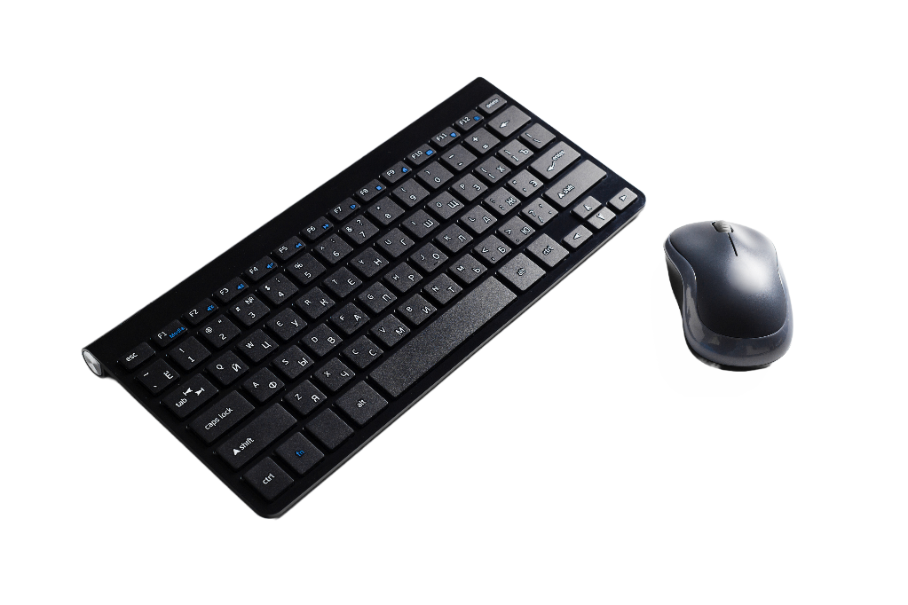
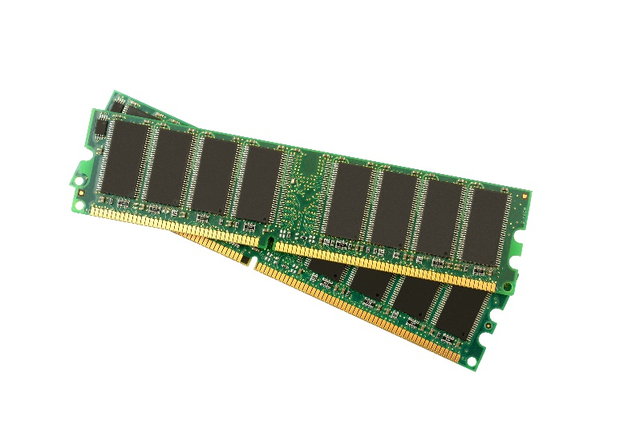

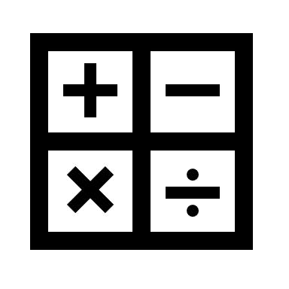
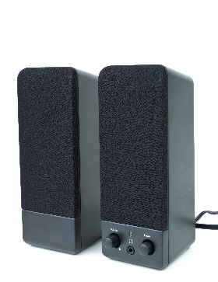
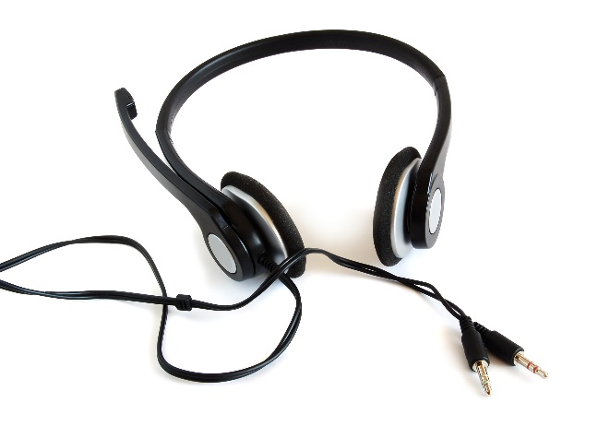
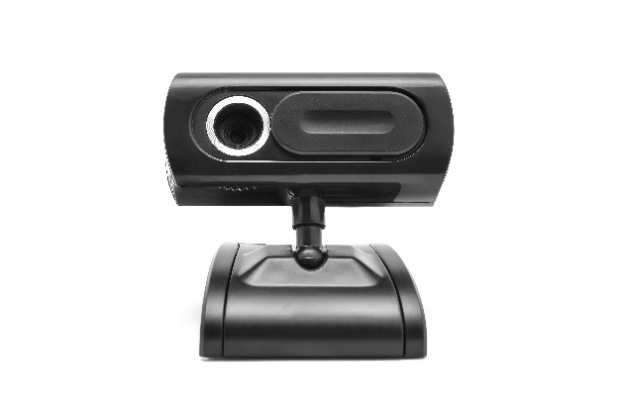
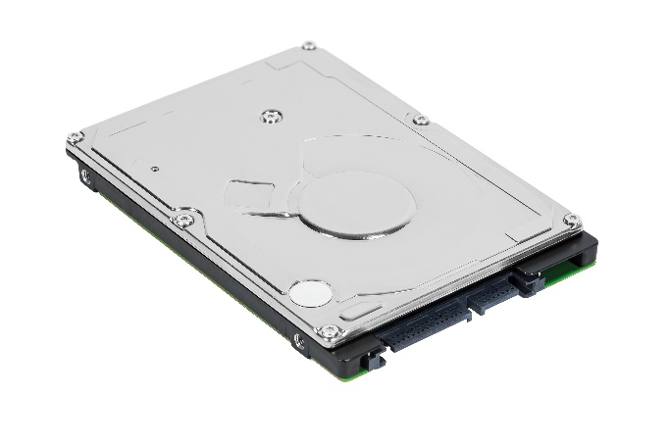
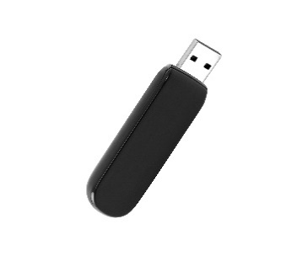
Review: What’s in the Box?
Input
CPU(s)
Memory
Output
Storage (I/O)
Notes:
OFF SCREEN
First, let’s look at the components of a typical personal desktop computer.
Some of the main components are Input devices, such as a mouse and a keyboard, output devices such as a display and speakers, and of course, the computer itself, that houses the CPU, memory, and storage. [CLICK]
For todays’ standards, this is probably incomplete. You probably have some headphones and a webcam connected to your desktop computer too.
[CLICK – Next Slide]

Slide 4

Review: What’s in the Box?
Notes:
ON SCREEN
Let’s go beyond and think about smartphones.
While the form factor is different than desktop computers, the architecture is quite similar.
There are inputs, outputs, a CPU, memory, storage.
What is interesting about smartphones (besides their small size) is that they usually carry input and output capabilities that go beyond that of a personal computer.
Think about it…
They are usually capable of sensing touch (although this is also becoming common in desktop and laptop computers), they vibrate as a form of output, they have gyroscopes that let them perceive changes in their position and accelerometers that allow them to perceive they are moved, GPS, compass, and so many other sensors that are rarely found in other computer form factors.
In this course, we will look at how the operating system manages all these input and output devices, including managing memory, and storage. While we will, most of the time, be concerned with Operating Systems typically associated with personal computers, most of the concepts translate directly to smartphones and wearable devices.
[CLICK – Next Slide]

Slide 5
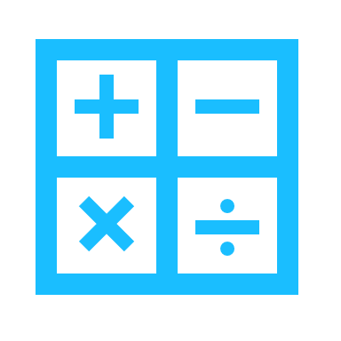

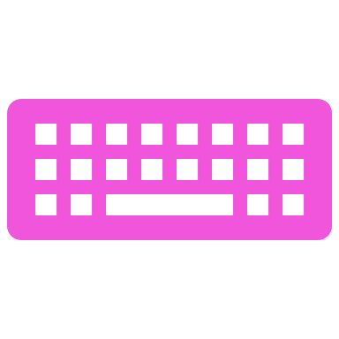

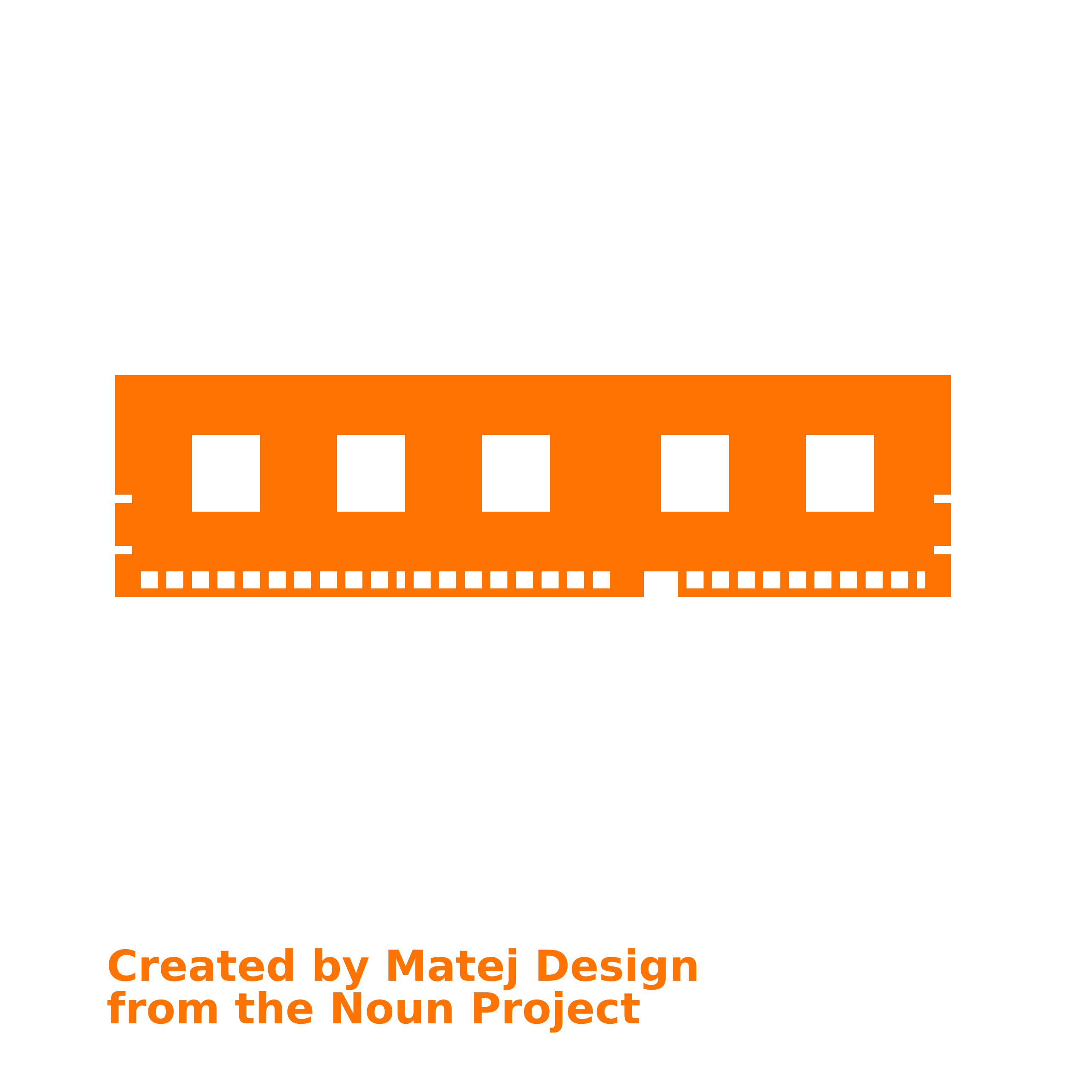
A Typical PC Architecture
CPU
Memory
Video Controller
USB Controller
Fixed Storage Controller
BUS
Notes:
OFF SCREEN
Several computer architectures have emerged over the years.
However, it is possible to identify main characteristics of a typical personal computer architecture.
Analyzing this sort of generic architecture gives us a basic understanding of personal computers and a baseline to begin discussing about operating systems.
There are a few important elements to this representation of a PC architecture.
Notice that all components are connected by a bus.
In computer architecture, a bus is a communication system that transfers data between components inside a computer.
We can think about them as physical wires that connect components.
In this representation, we also have controllers. We show a video, USB, and a Fixed Storage controller.
A controller, in a computing context, is a hardware device or a software program that manages or directs the flow of data between two entities.
[CLICK – Next Slide]

Slide 6
Inside the CPU (Core)
Registers
ALU
Control Unit
Registers
CPU Memory
Special & General Purpose
Arithmetic Logic Unit
Arithmetic computations
Logical computations
Control Unit
Tracks state / status
Controls other components
Notes:
OFF SCREEN
Now let’s look at the CPU core and its components. [CLICK]
The CPU is the component of a computer system that controls the interpretation and execution of instructions. [CLICK]
As you may recall from Computer Organization, some of the components of a CPU are the registers, Arithmetic Logic Unit (ALU), and the control unit. [CLICK]
A processor register ( or a CPU register) is one of a small set of data holding places that are part of the CPU.
A register may hold an instruction, a storage address, or any kind of data (such as a bit sequence or individual characters).
Registers are characterized by being small but extremely fast memory units. [CLICK]
An arithmetic-logic unit is the part of a central processing unit that carries out arithmetic and logic operations on the operands in computer instructions.
In some processors, the ALU is divided into two units: an arithmetic unit (AU) and a logic unit (LU). [CLICK]
The control unit of the CPU regulates and integrates the operations of the computer.
It selects and retrieves instructions from the main memory in proper sequence and interprets them so as to activate the other functional elements of the system at the appropriate moment.
[CLICK – Next Slide]

Slide 7
Ready, Set, Compute!
Instructions are executed via the fetch-decode-execute cycle.
Fetch
Load instruction
(PC → MAR → MBR → IR)
Decode
Find opcode / operand(s)
Interpret instruction
Execute
Carry out instruction
(Move data, ALU, etc.)
Protected instructions can only be executed in a protected state.
!
Notes:
OFF SCREEN
Instructions are executed by the CPU via the fetch-decode-execute cycle.
The CPU fetches an instruction from memory, decodes this instruction and then executes it.
The CPU carries out this cycle continuously, millions of times per second. [CLICK]
Some instructions can be executed by all processes running. However, some instructions can only be executed by the operating system itself. These are called protected instructions.
This allows the operating system to keep user programs from executing operations that could harm the system.
[CLICK – Next Slide]

Slide 8
Pipelining
We can speed up execution via pipelining.
Unit / Time | Tick 0 | Tick 1 | Tick 2 | Tick 3 | Tick 4
FETCH | INSTR-A | INSTR-B | INSTR-C | … | …
DECODE |  | INSTR-A | INSTR-B | INSTR-C | …
EXECUTE |  |  | INSTR-A | INSTR-B | INSTR-C
Three stage pipeline CPU
Superscalar CPU
Execute Unit
Fetch Unit
Decode Unit
Fetch Unit
Decode Unit
Execute Unit
Holding Buffer
Execute Unit
Fetch Unit
Decode Unit
Execute Unit
Notes:
OFF SCREEN
Another characteristic of typical architectures is to implement a pipelined execution of instructions.
Pipelining is the process of storing and prioritizing computer instructions that the processor executes.
The pipeline is a "logical pipeline" that lets the processor perform an instruction in multiple steps.
The processing happens in a continuous, orderly, somewhat overlapped manner. [CLICK]
The illustration shows a 3-stage pipeline. For each tick of the CPU, it can Fetch one instruction, decode another, and execute yet another.
This is possible since Fetching, Decoding, and Executing function as logically independent modules. This approach allows for maximum CPU utilization. [CLICK]
There are more complex architectures besides the 3-statge pipeline. Superscalar CPUs, for example, may contain several fetch units, several decode units, and several execution units. These units may have buffers between them to account for differences in execution speed at each point in the process.
[CLICK – Next Slide]

Slide 9
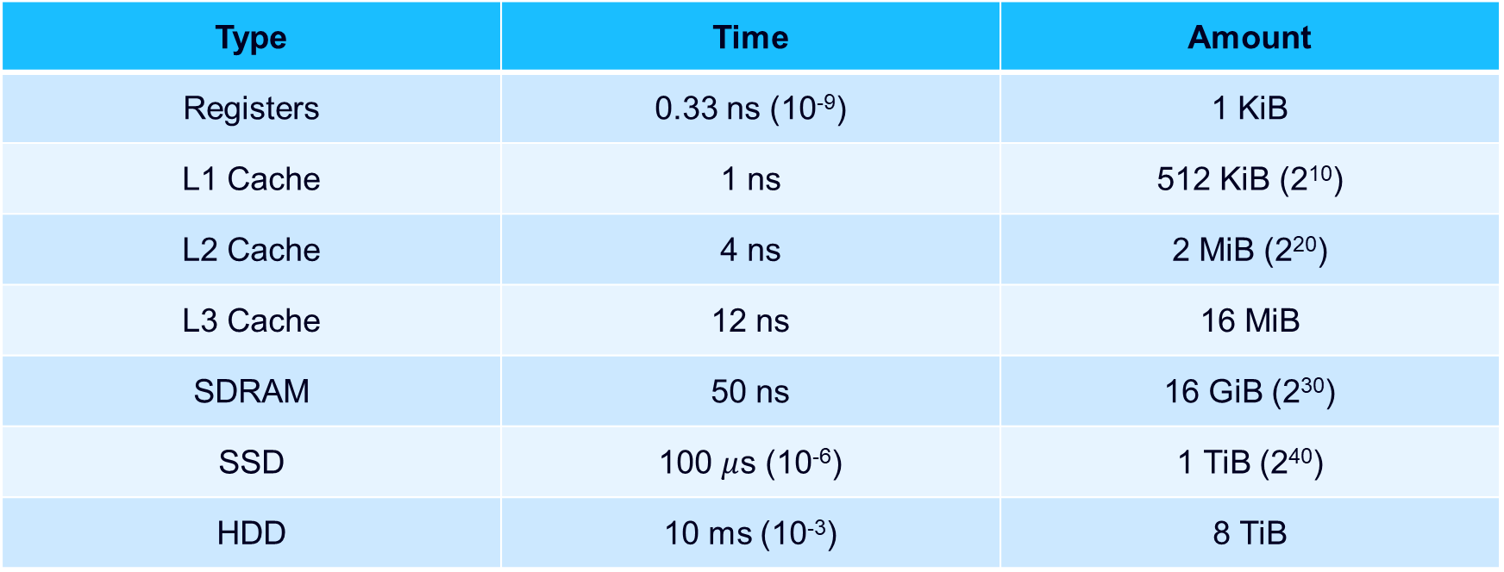
Access Times
Type | Time | Amount
Registers | 0.33 ns (10⁻⁹) | 1 KiB
L1 Cache | 1 ns | 512 KiB (2¹⁰)
L2 Cache | 4 ns | 2 MiB (2²⁰)
L3 Cache | 12 ns | 16 MiB
SDRAM | 50 ns | 16 GiB (2³⁰)
SSD | 100 $μ$s (10⁻⁶) | 1 TiB (2⁴⁰)
HDD | 10 ms (10⁻³) | 8 TiB
8-Core Skylake Processor
Notes:
OFF SCREEN
Now let’s look at the organization of a computer from a memory and storage size and speed point of view.
The illustration shows different types of memory, their access times, and the typical size of each memory.
While the typical sizes of each memory type may grow over time as technology advances, the main information that concerns us is the relationship between the sizes.
These memories are organized from top to bottom according to how close to the CPU they are. [CLICK]
Registers are typically in the same die as the CPU. It is inside the CPU. [CLICK]
Caches L1, L2, and L3, are also very close to the CPU. [CLICK]
SDRAM is a type of main memory. It is connected to the CPU by a bus. [CLICK]
SSDs and HDDs are types of storage, also connected to the CPU by a bus.
Notice that the access time and the size of each memory grow the farther they are from the CPU. An inverse relationship is formed regarding cost. The farther from the CPU the lower the cost.
[CLICK – Next Slide]

Slide 10
Memory Size Units
SI | Abbr | Exp | Alt | Exp | Explicit
Kilo | KB | 10³ | KiB | 2¹⁰ | 1,024
Mega | M | 10⁶ | MiB | 2²⁰ | 1,048,576
Giga | G | 10⁹ | GiB | 2³⁰ | 1,073,741,824
Tera | T | 10¹² | TiB | 2⁴⁰ | 1,099,511,627,776
Peta | P | 10¹⁵ | PiB | 2⁵⁰ | 1,125,899,906,842,624
Exa | X | 10¹⁸ | EiB | 2⁶⁰ | 1,152,921,504,606,846,976
Zetta | Z | 10²¹ | ZiB | 2⁷⁰ | 1,180,591,620,717,411,303,424
Yotta | Y | 10²⁴ | YiB | 2⁸⁰ | 1,208,925,819,614,629,174,706,176
Hella? | H | 10²⁷ | HiB | 2⁹⁰ | 1,237,940,039,285,380,274,899,124,224
Notes:
OFF SCREEN
One important distinction when discussing memory and memory sizes is that, when talking about computer systems, we measure size as powers of 2.
This is due to the binary nature of how we store computer information.
This is a source of confusion since we are more used to thinking in terms of powers of 10. [CLICK]
For example, a kilobyte, represented as KB is 10 to the power of 3, or 1000 bytes. However, when taking about memory, we typically refer to two to the power of 10, which equal 1024 bytes.
The actual name given to this is a Kibibyte.
In this course, whenever kilo is mentioned, it refers to 2 to the power of 10. The same goes for the other measuments.
Note that while the difference between a kilobyte and a kibibyte is just 24 bytes, the difference grows fast. Look at Exa. 10 to the power of 18 is much smaller than 2 to the power of 60.
So, it is important to be mindful of these differences.
[CLICK – Next Slide]

Slide 11


The Boot Process
Notes:
ON SCREEN
Now, let’s talk about the boot process.
Booting is the process of starting a computer as initiated via hardware such as a button or by a software command.
After it is switched on, a computer's CPU has no software in its main memory, so some process must load software into memory before it can be executed.
[CLICK – Next Slide]

Slide 12
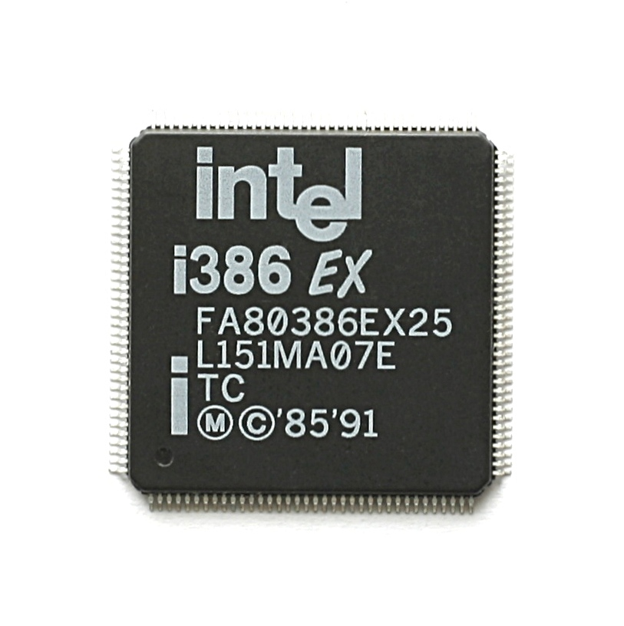
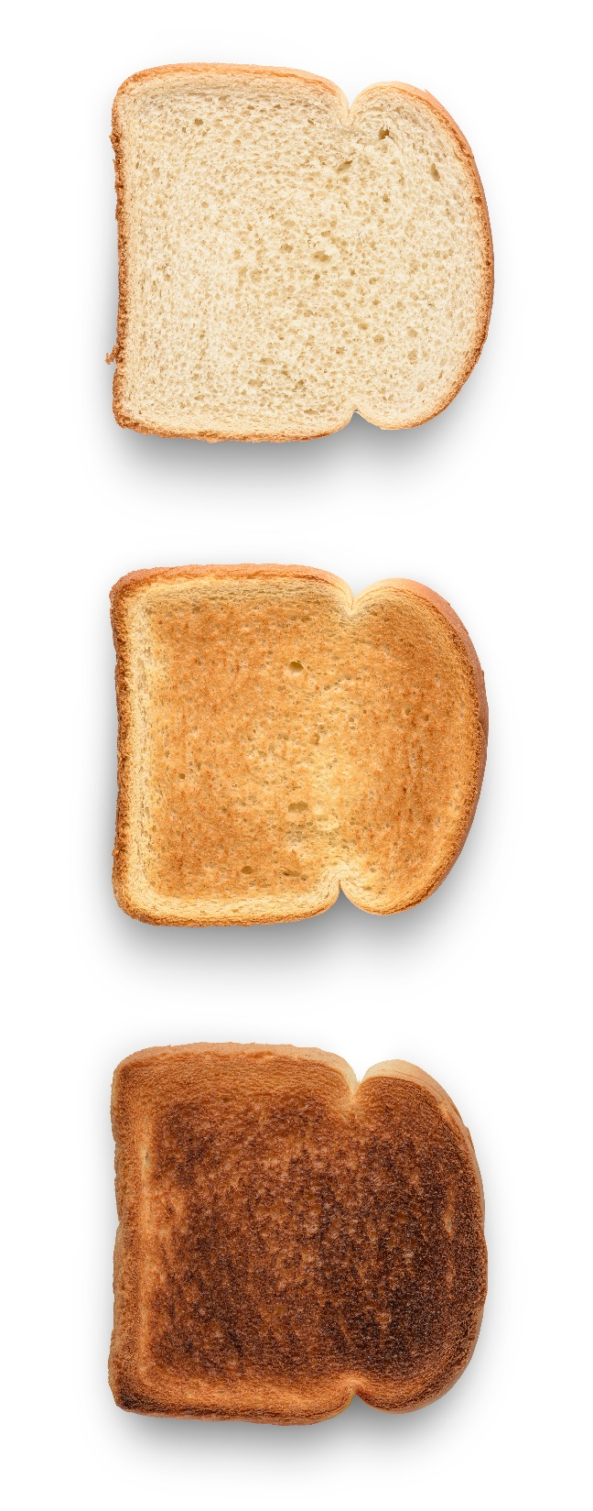
I386 Boot Process
(Lanzet, 2009)
Notes:
ON SCREEN
Let’s begin by talking about what typically happens during the boot process of an I386 type of machine.
The Intel 386 is a 32-bit microprocessor introduced in 1985.
The first versions were the CPU of many workstations and high-end personal computers of the time
The I386 belong to the family of X86 computers.
X86 is the term used to denote the microprocessor family based on the Intel 8086 and 8088 microprocessors.
These microprocessors ensure backward compatibility for instruction set architectures.
Initially x86 started with an 8-bit instruction set, but then grew to 16- and 32-bit instruction sets.
[CLICK – Next Slide]

Slide 13
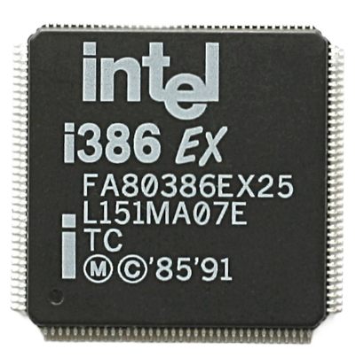
I386 Boot Process - BIOS
BIOS = Binary Input and Output System (Legacy - circa 2017)
(Lanzet, 2009)
1
Execute BIOS Init (drivers, etc.).
Boot Sector
Master Boot Record
2
Run Power-On Self Test (POST).
3
Get boot device via NVRAM (no standard).
Load “Boot Sector” into volatile RAM.
Unpartitioned
Partitioned
4
5
Execute Boot Block program from the Boot Sector (one block).
6
Bootstrap OS with Boot Loader routine (flexible).
Bootloader
Notes:
OFF SCREEN
Now, let’s look at the boot process. [CLICK]
The typical boot process of an I386 machine was managed by a BIOS.
BIOS (basic input/output system) is the program a computer's microprocessor uses to start the computer system after it is powered on.
One important information is that the Bios was typically stored in a Read-only memory or ROM chip.
Different Bios systems were manufactured by several companies, however with very little standardization among them.
Companies such as American MegaTrends, Phonix Systems, and Award are some companies that produced Bios chips. [CLICK]
During the boot process, the Bios is executed and performs an initialization process.
This initialization checks if basic components such as the display and keyboard are connected. If these basic components are found, a Power-On self test or POST procedure is executed.
Note that, at this point, if there are any missing or malfunctioning elements, the computer will emit sequences of beeps. The beeping pattern can be used to diagnose some system problems, like the absence of a keyboard or malfunction memory hardware.
The POST process checks RAM, processor, drives, system interface, etc. [CLICK]
If the the POST is successful, the Bios looks for a boot device. Put simply, it looks for the disk where an operating system can be found.
That information is stored inside a non-volatile ram. This is a type of memory that can be re-written but will retain information when the computer is turned off.
Note that because there was little standardization among different Bios manufacturers, the information inside NVRAMs changed depending on the manufacturer.
As a consequence, most bios information (such as the disk where the OS existed) had to be entered directly in the Bios, and could not be managed by the operating system. [CLICK]
Once a boot device is identified, the bios reads the first sector of the boot disk into main memory.
The first sector has a special name. It is called the “boot sector”. [CLICK]
The main information in the boot sector is the Boot Block program.
The boot block program is a program that contains the address in memory where the program that initializes the OS can be found. [CLICK]
Once executed, the boot block program initiates or bootstraps the OS by calling the OS Boot loader. The OS boot loader is a more complex program that actually initialized the OS.
Each OS will have their own boot loader program. Also important, the boot loader program can be anywhere in the disk and have any size.
The boot loader program completes the sequence and the OS is loaded, completing the boot process.
Now let’s look at how the bios deals with systems that have two or more operating systems installed. [CLICK]
How does it know which system to initialize?
A few changes happen when two or more operating systems exist inside the same disk.
We are assuming a single disk drive that has multiple partitions. This means that while there is only one physical disk, logically the system will see each partition as an independent disk. In the example, the red partition represents one logical disk containing one operating system, while the green partition represents another logical disk containing another operating system.
Note that the boot sector, which is the first sector of a disk is now called the master boot record. Instead of pointing to the Bootloader, the master boot record typically contains the program the will show a small menu to users when the computer is started.
That menu will allow users to select to start one operating system or the other.
Once the user selects one of the operating systems, the first sector of the partition corresponding to the OS selected is loaded into memory, and the process continues with the execution of the boot block program and the bootloader, as was described before.
The additional material contains the link to an instructional video showing the bios and power-on process.
It is an interesting opportunity to see how systems have evolved. Notice, for example, that while most checks and validations still happen during the boot process, in modern systems they are hidden from the user, presenting a much cleaner and pleasant user experience.
[CLICK – Next Slide]

Slide 14
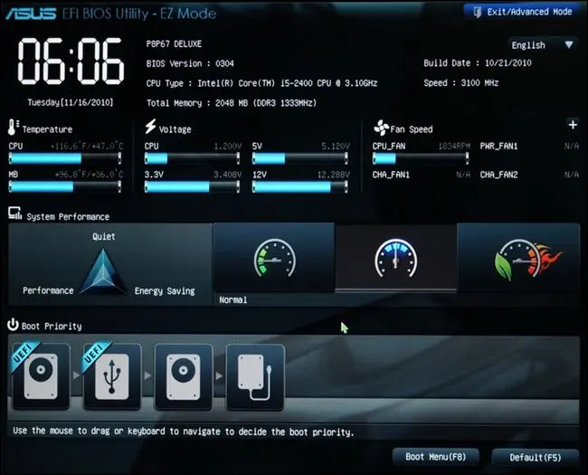
X64 Boot Process - UEFI
(Hoffman, 2023)
Notes:
ON SCREEN
Now let’s look at the boot process that is currently found in most modern systems.
Modern systems have replaced the BIOs by the UEFI architecture. UEFI stands for Unified Extensible Firmware Interface.
More importantly, it is a standard for the implementation of boot process systems. This is very important.
Because it is a standard, the operating system can assume where basic information about the system is stored.
For example, this allows the Operating System to manage boot disks, disk partitioning, and other low-level system configurations. As a consequence, users can change those settings from within the operating system, without having to access the UEFI interface during the boot process to change most of those configurations.
The UEFI is typically found in X64 systems.
Similar to the x86, the x64 is also a family of instruction set architectures (ISA) for computer processors.
However, x64 refers to a 64-bit CPU and operating system instead of the 32-bit system which the x86 stands for.
Note that some X64 still have Bios, and some i386 support UEFI (but not all). Still, typically the UEFI is associated with X64 systems.
[CLICK – Next Slide]

Slide 15
X64 Boot Process - UEFI
UEFI = Unified Extensible Firmware Interface Standard (New Hotness)
Protective MBR
Partition Entities
1
Primary Header
Execute architecture firmware.
2
Execute EFI Manager (init & drivers).
3
Get boot device via NVRAM (standardized).
4
On disks, get boot loader from EFI partition.
EFI Partition
Partition Entities
Bootloader
Secondary Header
Notes:
OFF SCREEN
The UEFI process to initialize an operating system is similar to the Bios. [CLICK]
During the boot process, the UEFI is executed and performs an initial verification and initialization process of the computer’s hardware.
This initialization checks basic components such as the display and keyboard. [CLICK]
Then, the EFI Manager is executed. It defines how the boot process should proceed.
In this process, the EFI looks for the boot device location. In other words, it looks for the disk where an operating system can be found.
Like in the bios, this information is stored in a non-volatile ram, whoever, here the information stored in the Nvram is standardized. [CLICK]
Once the disk is located in the Nvram, the EFI partition for that disk is accessed, and the bootloader for the OS is called. [CLICK]
Now let’s look at how the information is stored. There are some interesting features implemented by UEFI. [CLICK]
First, in UEFI systems, the first sector of the disk is reserved – it is called the Protective master boot record. There, a message is kept that can be read by older bios systems.
The message warns users that the disk uses UEFI and may contain an operating system.
This is done so that if a disk that contains information structured in the UEFI format is inserted in a system running Bios users will be warned not to format the disk imagining that it is empty or corrupt.
While they may choose to do so, users at least will receive a warning message. [CLICK]
In UEFI the initial information about the disk is kept in the second sector of the disk. That sector is called the “Primary Header.”
The primary header contains information about basic disk information such as capacity, sector size, and the number of sectors. It also contains basic information describing the partitions that exist in the disk. [CLICK]
UEFI disks have several partitions, even if they host only a single operating system.
The first partition is a partition that contains partition entries. This partition is called “Partition Entries.” It stores metadata about the existing partitions. This includes labels, sizes, and structure information. [CLICK]
Another partition always present in UEFI systems is the EFI partition. [CLICK]
This partition contains bootloaders. In the example, the EFI partition contains bootloaders for the OS in the red and for the OS in the green partition.
With all bootloaders in a single partition, bootloaders can be better protected, including from attacks from a computer virus.
Bootloaders have the same role as in the Bios systems. The initialize operating systems. [CLICK]
Another partition that is always present in UEFI systems is another partition that contains partition entries. This is a copy of the partition entries in the beginning of the disk.
This is a safety measure. If the partition entries in the beginning of the disk are lost or corrupted, the secondary partition entries in the end of the disk is used to restore that information.
While some space is wasted, this safety feature can guarantee the integrity of the disk and assist in recovering when issues happen. [CLICK]
Finally, a copy of the primary header sector is also maintained for similar reasons.
As you can see, the UEFI is better in many ways. It is standardized and implements many safety features.
If these basic components are found, a Power-On self test or POST procedure is executed.
Note that, at this point, if there are any missing or malfunctioning elements, the computer will emit sequences of beeps. The beeping pattern can be used to diagnose some system problems, like the absence of a keyboard or malfunction memory hardware.
[CLICK – Next Slide]

Slide 16

ARM Boot Process
ARM (like many platforms) has no standardized boot process.
However, some folks (e.g., SuSE) are working on UEFI for ARM and other platforms.
(Dunning, 2008)
Notes:
OFF SCREEN
Unfortunately, while UEFI has been widely adopted by systems based on Intel instruction sets, a similar standardized boot system has not emerged for ARM processors.
Intel instruction set processors implement CISC architectures or a complex instruction set architecture.
In CISC architectures, single instructions can be complex and execute several low-level operations with a single instruction.
ARM processors are a family of CPUs based on a reduced instruction set architecture.
ARM stands for Advanced RISC Machine. RISC instructions are faster and typically simpler then CISC instructions.
To achieve the same task, a Risc cpu may have to execute several small instructions, while a Cisc cpu may complete the same task with a single (albeit more complex) instruction. [CLICK]
While there is no leading standardized boot process, some companies that develop distributions of Linux systems have begun to explore implementing UEFI for ARM architectures.
[CLICK – Next Slide]

Slide 17
Conclusion
Notes:
ON SCREEN
And this completes our exploration of computer hardware fundamentals.
See you next time!
[CLICK – Next Slide]

Slide 18
Thank You For Watching

Slide 19
References
Dunning, B. (2008). Here Be Dragons [Online Image]. IMDB. https://www.imdb.com/title/tt1262906/
Hoffman, C. (2023). Screenshot of UEFI [Online Imag]. How-To Geek. https://www.howtogeek.com/56958/htg-explains-how-uefi-will-replace-the-bios/
Lanzet, K. (2009). Image of a CPU Intel i386EXTC [Online Image]. Wikimedia Commons. https://commons.wikimedia.org/wiki/File:KL_Intel_i386EX.jpg

